Slide 1
Application of DVRPC Data
Temple Modeling Group
10/2

Slide 2
Data Received
Numerous 3399X3399 Matrices defining various values
Impedance, Physical Distance, In Vehicle time, etc.
Values for the nodes
Populations ( high and low), employment opportunities (high and low) and many many others

Slide 3
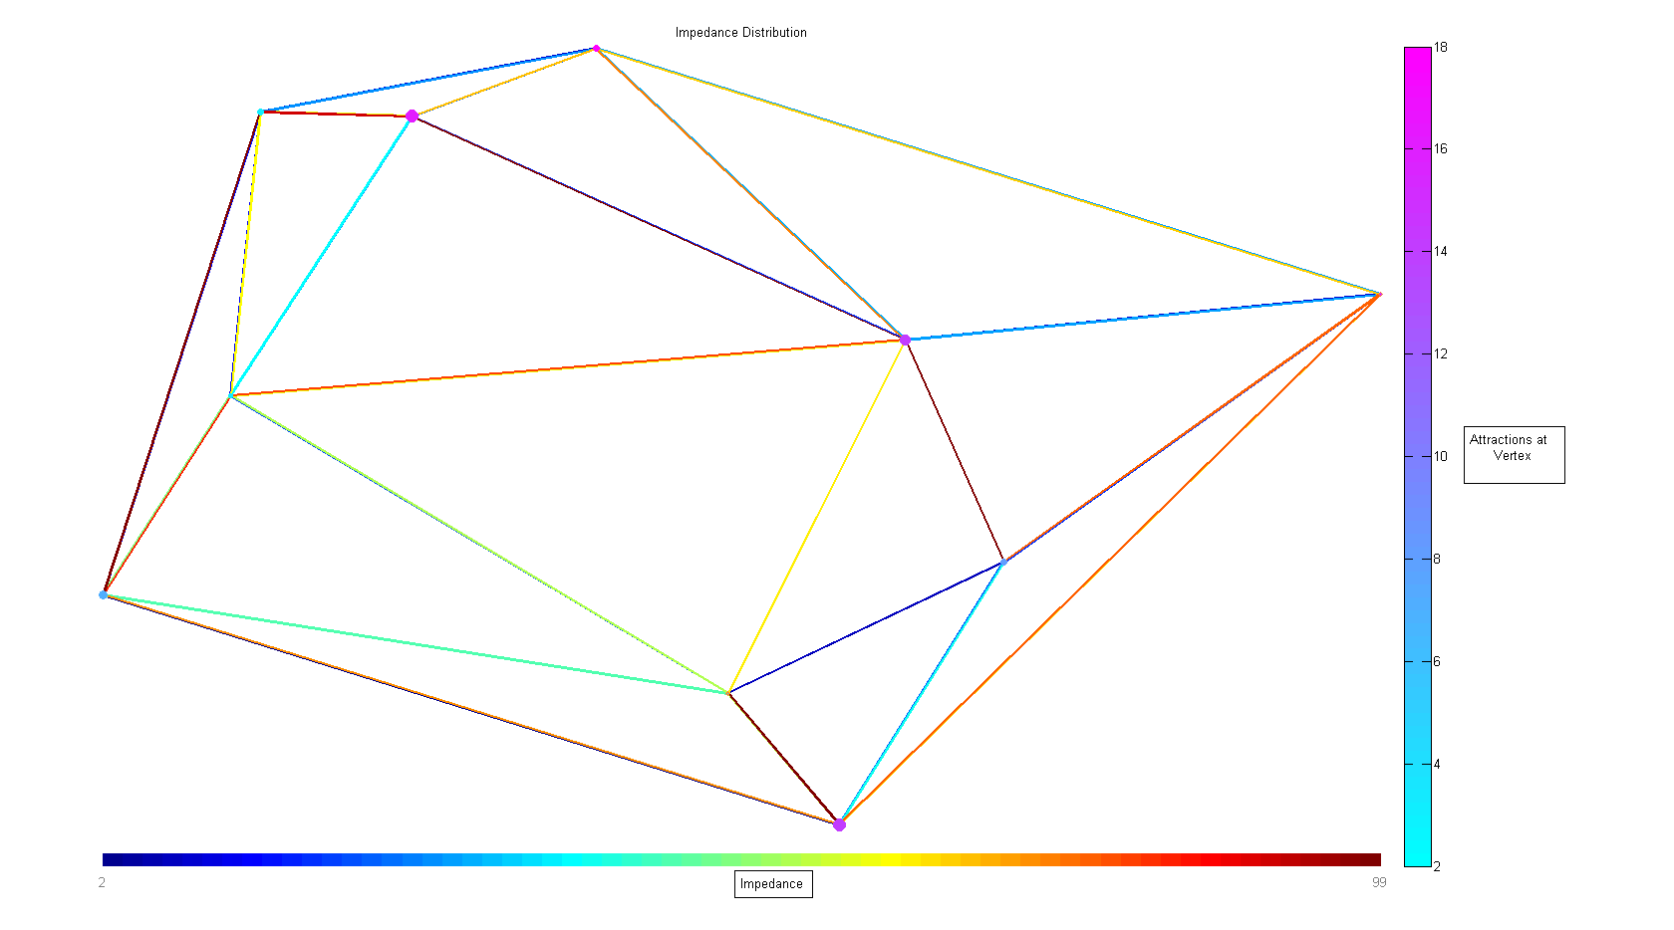
Simple Example of Impedance Plot

Slide 4
Confused?
Lots of data points to show
Impedance of each edge.
Non-symmetric matrix
Population at each node
Represented by the size of the node
Attractions at each node
Represented by the color of the node
Connected Graph
Some type of limiting criteria needs to be used

Slide 5

Graph of Impedances – 100 Nodes Downtown

